Slide 1

Final Year Project (FYP)
University of Salahaddin-Erbil
College of Engineering
Software and InformaticsDepartment
Student Name:
Lana Muhammad Jawher
Zaynab Azad Khdir
Rondik Hadi Abdulrahman
Noor Muner ishaq
Supervisor Name: Hanan Kamal

Slide 2
Introduction
In most of the curriculums undergraduate programmers, it is common that students are expected to complete a comprehensive software development project in their final year studies.
However to overcome the various problems encountered during the implementation of the FYP in the previous years, we decided to develop a final year project management system which is a web-based system to serve the whole process and reduce extra hard work .

Slide 3
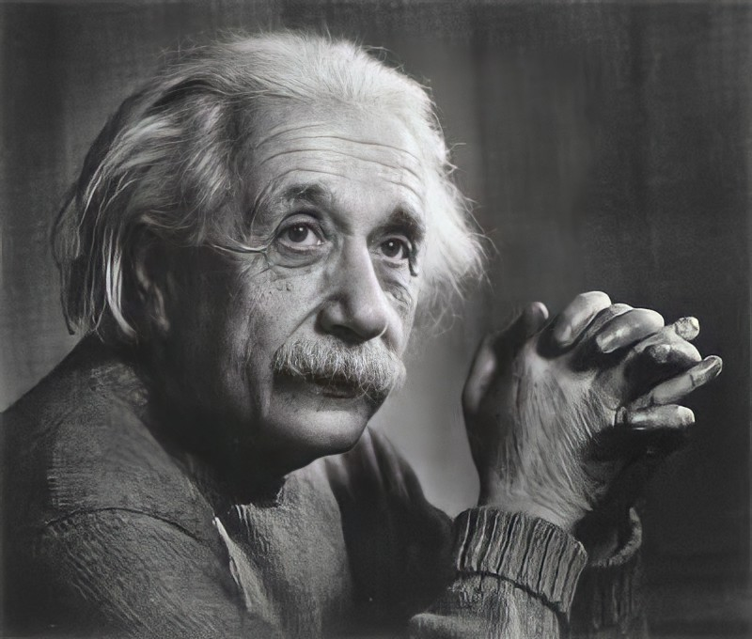
Problem definition
In order to avoid the process to be done manually
All information are kept in online database information can be easily managed without keeping hard-copy
Save time and effort
System is user friendly and ease to use
No third party can interrupt the process

Slide 4
Project Objectives

Slide 5
web-based application for storing:
students’ information.
supervisor’s descriptions of the projects.
committee notes.
calculation that will be made for assigning the projects.
That will help the committee for:
Keeping everything organized.
Save time in many aspects.
Tracking the whole system.
No paper work need.
Very easy to modify any information in the system.

Slide 6
Project Feasibility
Partitioning every section of the project.
Front-end and back-end languages features.
Conform legal requirements.
Using forms.
End on time.
More features to be add.

Slide 7


Student
Admin
The system contains
two pages
01.
02.

Slide 8
SYSTEM ANALAYSIS
The student page will contain three forms:
Login form
Selecting group member form
Movable project list form
The system will choose the project by the average grade of the group.
The admins' page contains:
Login form with selecting the level of the admin , Levels are:
1. Lecturer form contain:
Create project form

Slide 9
SYSTEM ANALAYSIS
2. Scientific committees form contain:
Project agreement form
The system will accept the project with the specified percentage of agreement project.
3. Top-admin & under-Top-admin form contain:
A form to enter the modification of the student’s & all other levels form.
The difference between Top-admin & under-Top-admin is that the Top-admin can modify the under-Top-admin form which under-Top-admin can not.
About the planning we completed the design and DB structure, the next step would be implementing the system coding.

Slide 10







OVERALL ACTIVITY
Design Database (ER Diagram and Code)
Analysis Requirement
Planning
Gathering requirement
UI/UX Design
Use-case Lucid-Chart
Write Presentation

Slide 11
TASKS
01.
02.
03.
Analysis
System Design(UML Diagram)
Requirements Gathering
04.
05.
06.
Design front-end
Use-case Lucid-Chart
Write Presentation
07.
08.
09.
Front-end Code
Back-end Code
Write final report

Slide 12
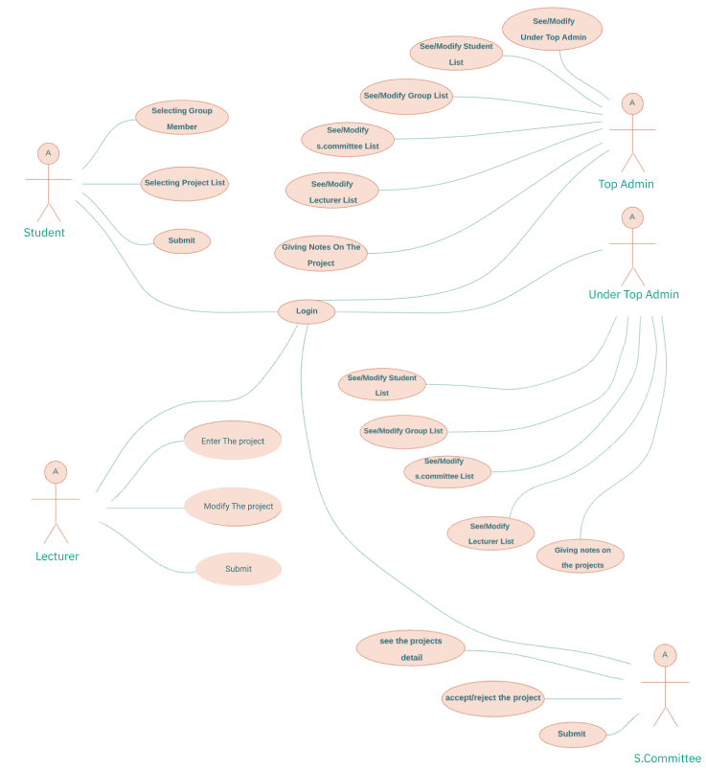
The system

Slide 13
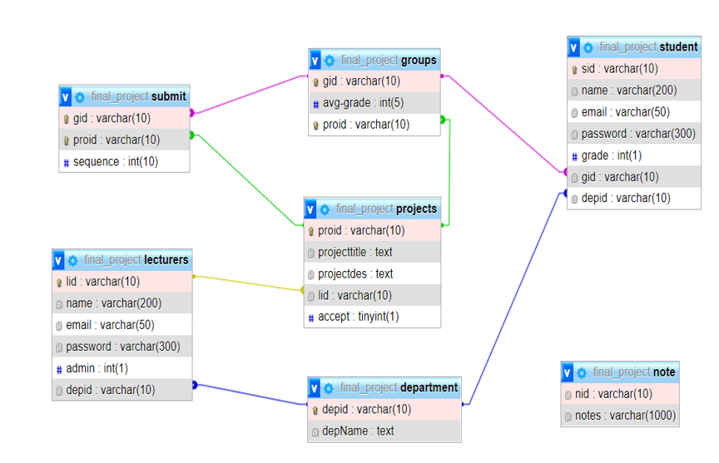
ER diagram

Slide 14
UI/UX DESIGN

Slide 15




RISKS
Operational risks
Programmatic risks
Schedule risk
Technical risks

Slide 16
RESSOURCES
(Web Server) -> XAMPP
(Design - UX / UI ) -> FIGMA
(Use-case diagram) -> Lucid Chart
(IDE) -> VS Code
(Front-end) -> HTML, CSS, Bootstrap, JavaScript & libraries
(Back-end & Database) -> PHP, MySQL

Slide 17
Task Name | Start Date | Finish Date | Duration
Gathering requirements | 18/10/2021 | 25/10/2021 | 1 week
Analysis Requirements | 25/10/2021 | 1/11/2021 | 1 week
Planning and Design the Database | 1/11/2021 | 7/11/2021 | 1 week
Create Database | 16/10/2021 | 18/10/2021 | 2 days
UI/UX | 29/11/2021 | 6/12/2021 | 1 week
Plan for front-end | 7/12/2021 | 7/12/2021 | 1 day
Create use-case diagram | 10/12/2021 | 10/12/2021 | 1 day
Search resources for the report | 22/11/2021 | 28/11/2021 | 1 week
Write Presentation | 1/12/2021 | 10/12/2021 | 10 days
Front-end Code | 15/1/2022 | 1/3/2022 | 1 month
Back-end Code | 1/3/2022 | 1/4/2022 | 1 month
Write Report | 1/2/2022 | 15/5/2022 | 3 months (during the implementation)

Slide 18
Conclusion
Final Year Project (FYP) offers good features that assist in managing the final year projects information without the computer printout forms.
This project tries to develop an online platform that facilitates the final year projects (FYP) process with the slightest effort to select the project.

Slide 19
REFERENCES
Sandeep Jain, Educational Institution, 2009, Indian Institute of Technology Roorkee.
https://www.geeksforgeeks.org/types-of-feasibility-study-in-software-project-development/
https://www.geeksforgeeks.org/different-types-of-risks-in-software-project-development/
2/2/2011, how to write report, Cardiff University School of Computer Science and Informatics
https://pats.cs.cf.ac.uk/wiki/lib/exe/fetch.php?media=project-report.pdf
System Design, Modeling, and Simulation using Ptolemy II, Ptolemy.org, 2014
https://ptolemy.berkeley.edu/books/Systems/PtolemyII_DigitalV1_02.pdf

Slide 20
THANK YOU
Any question ?

